Slide 1
Discussion 8
Stream Data

Slide 2
Roadmap
Stream data
Reservoir sampling (data sampling)
Bloom filter (if one item ever appeared in the datastream)

Slide 3

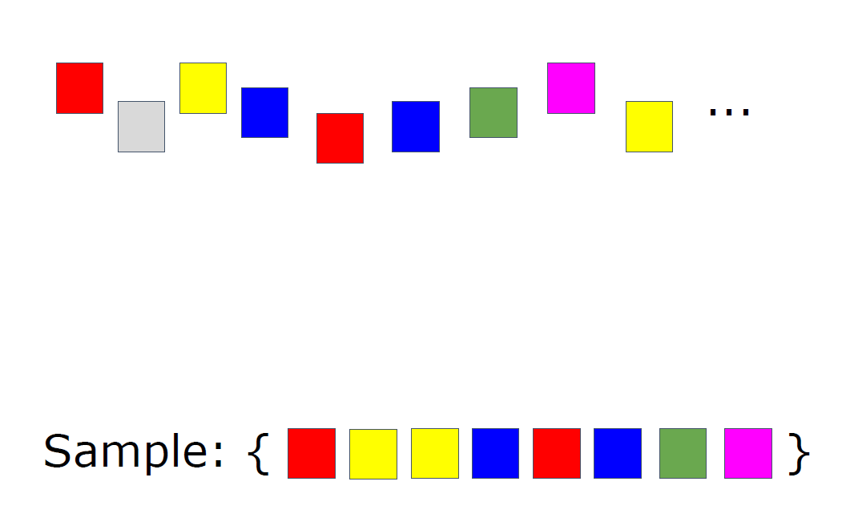
Reservoir Sampling
A family of sampling algorithm
Notes:
Data stream is the stream of water; our sample is the reservoir.

Slide 4
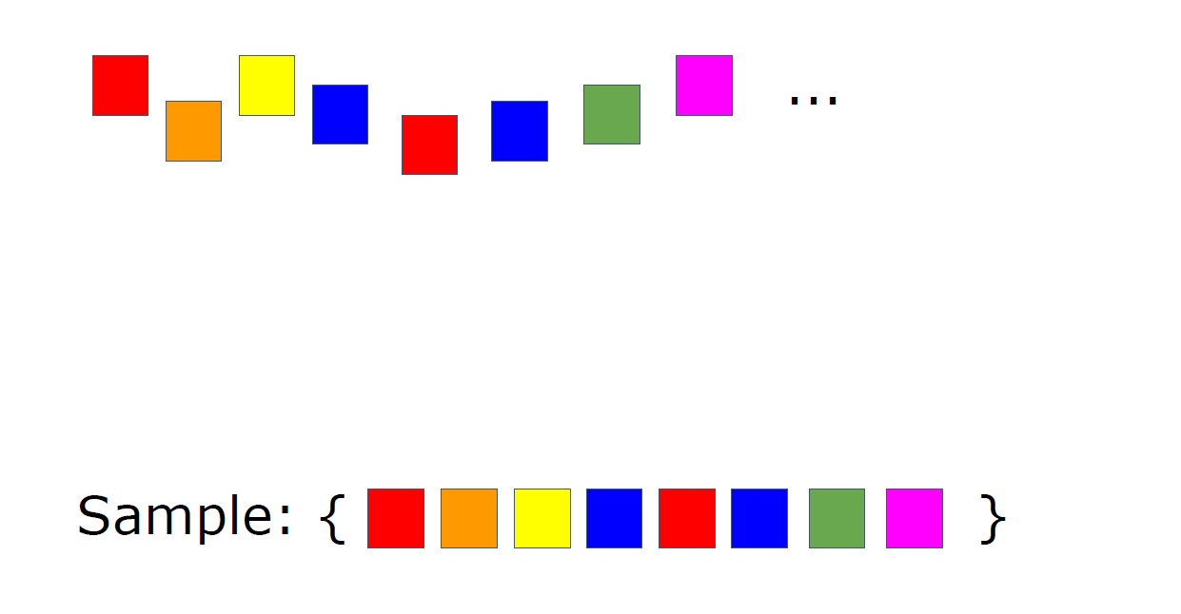
Review (Algorithm introduced in class - Algorithm R)
Notes:
Pictures from lecture slides

Slide 5
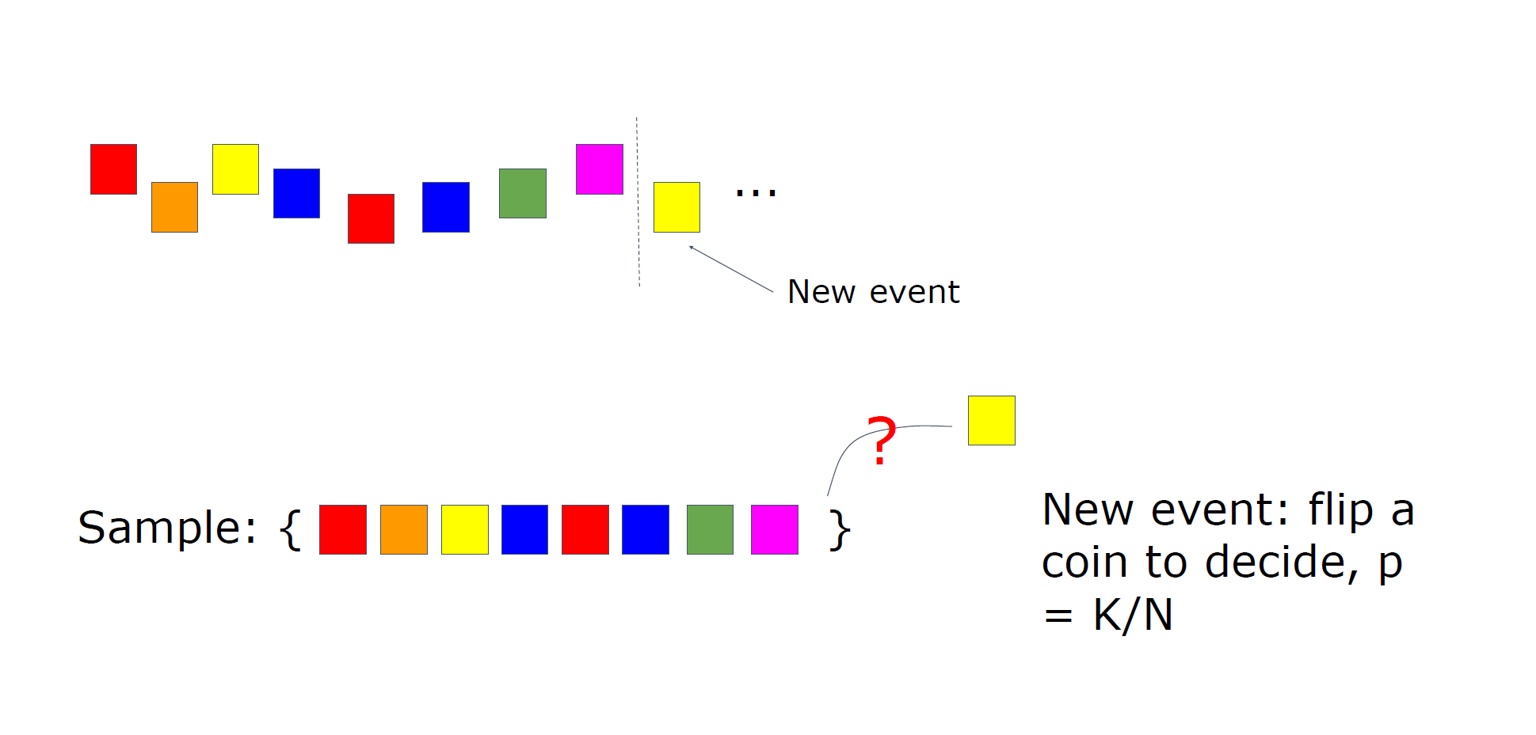
Review (Algorithm introduced in class - Algorithm R)
Notes:
Pictures from lecture slides

Slide 6
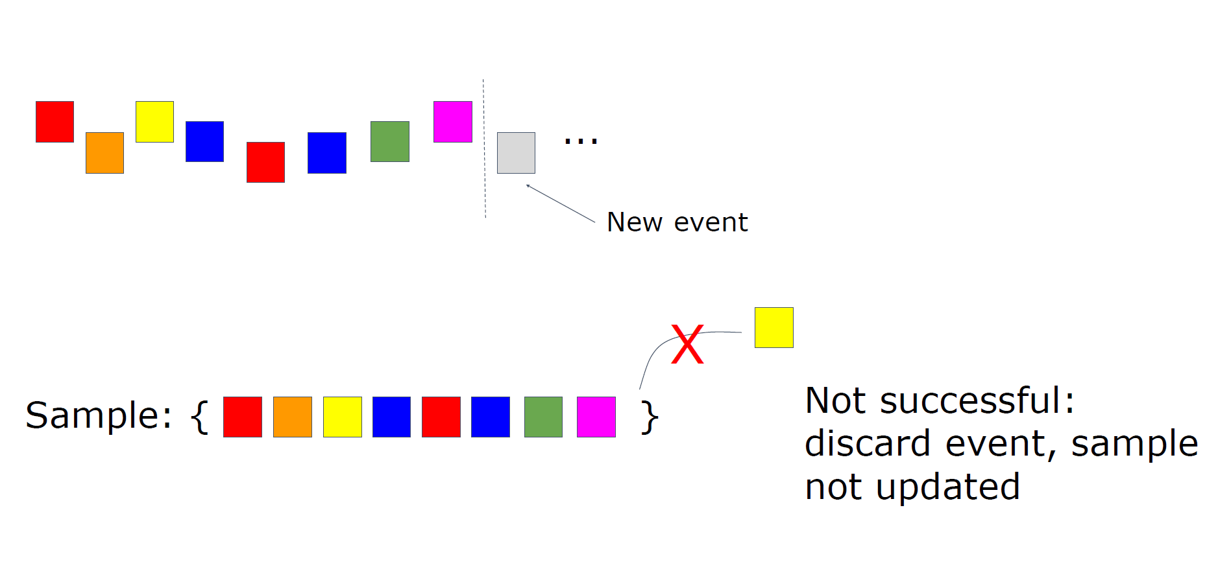
Review (Algorithm introduced in class - Algorithm R)
Notes:
Pictures from lecture slides

Slide 7
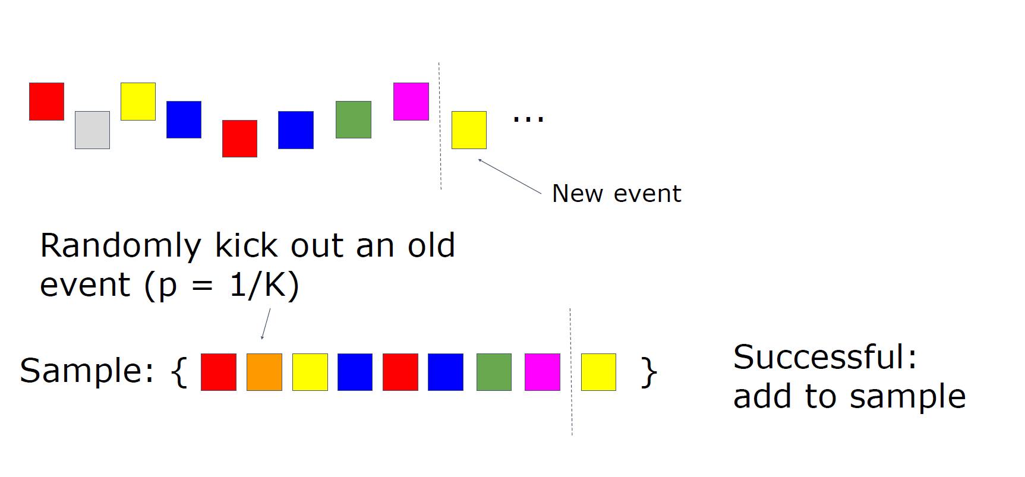
Review (Algorithm introduced in class - Algorithm R)
Notes:
Pictures from lecture slides

Slide 8
Bloom Filter
“Probabilistic data structure”
Goal: check if an item ever appeared in data stream
Suitable when type of items are huge

Slide 9
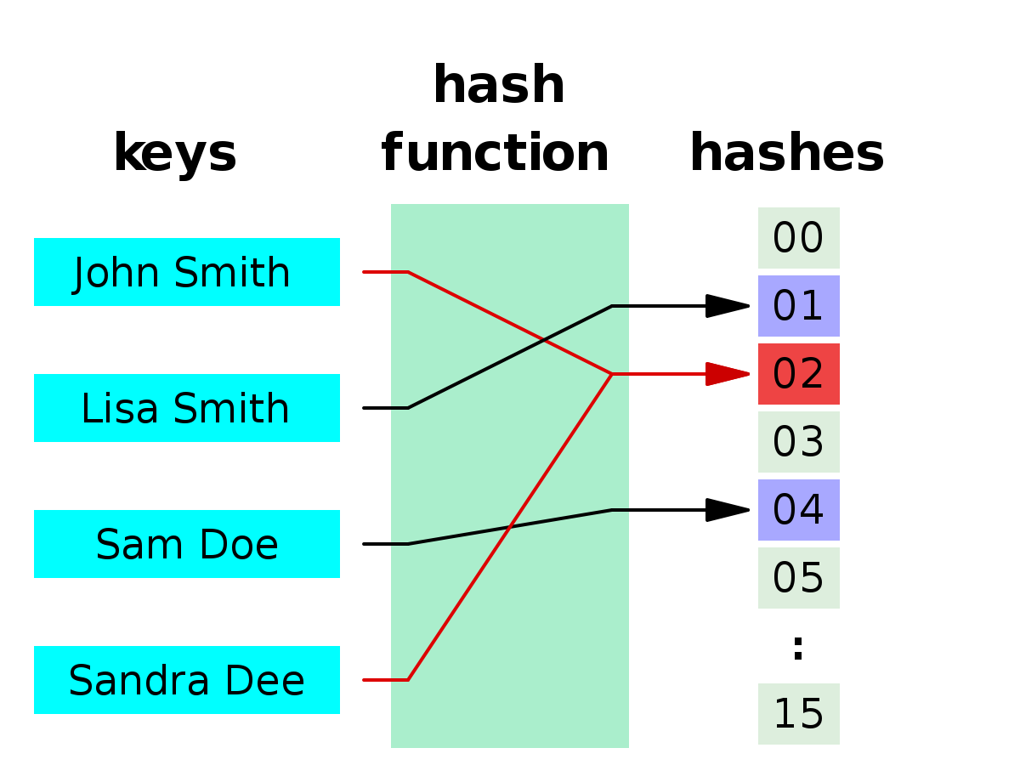
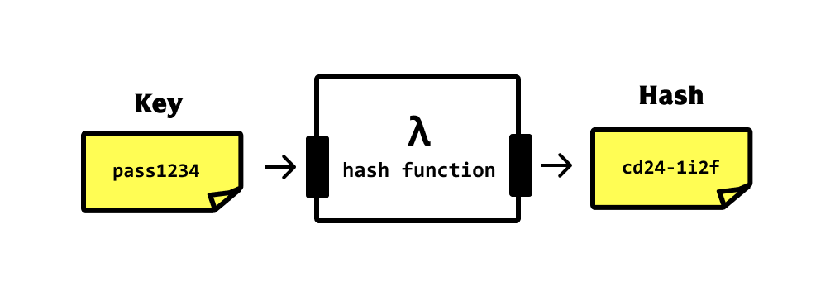
Hashing
Map data to a fixed length value
In security: cryptographic method
Notes:
Image source:
https://www.google.com/url?sa=i&url=https%3A%2F%2Fen.wikipedia.org%2Fwiki%2FHash_function&psig=AOvVaw09bFbQZRRJFE7fVOgUGkXH&ust=1667435422003000&source=images&cd=vfe&ved=0CAwQjRxqFwoTCMC06ZyfjvsCFQAAAAAdAAAAABB-
https://www.google.com/url?sa=i&url=https%3A%2F%2Fkhalilstemmler.com%2Fblogs%2Fdata-structures-algorithms%2Fwhat-is-hashing%2F&psig=AOvVaw09bFbQZRRJFE7fVOgUGkXH&ust=1667435422003000&source=images&cd=vfe&ved=0CAwQjRxqFwoTCMC06ZyfjvsCFQAAAAAdAAAAABB5

Slide 10
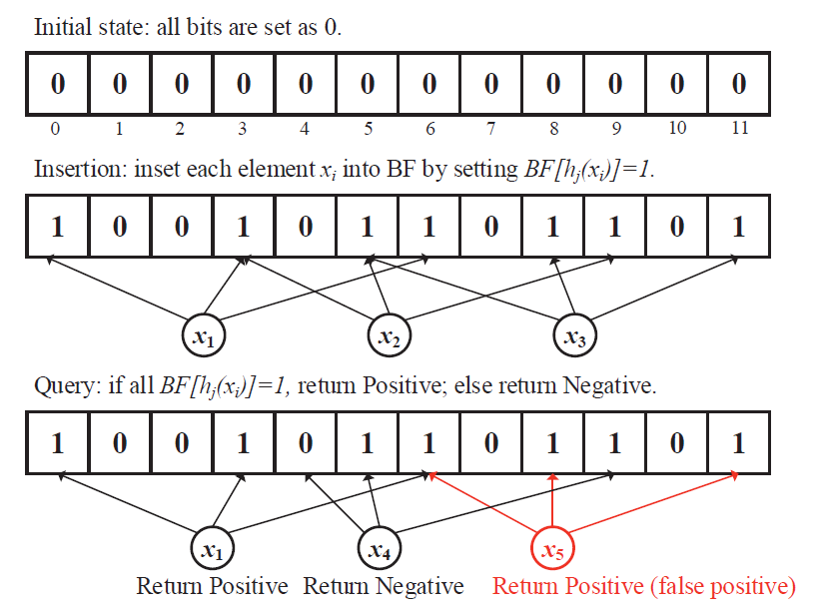
Bloom Filter - fingerprints of items
Notes:
Image source:
https://www.google.com/url?sa=i&url=https%3A%2F%2Fdevopedia.org%2Fbloom-filter&psig=AOvVaw0CJ7kjv1TbT_79i7U6I211&ust=1667435934649000&source=images&cd=vfe&ved=0CAwQjRxqFwoTCPC_-42hjvsCFQAAAAAdAAAAABAh

Slide 11
Bloom Filter - fingerprints of items
Notes:
Image source:
https://www.google.com/url?sa=i&url=https%3A%2F%2Fdevopedia.org%2Fbloom-filter&psig=AOvVaw0CJ7kjv1TbT_79i7U6I211&ust=1667435934649000&source=images&cd=vfe&ved=0CAwQjRxqFwoTCPC_-42hjvsCFQAAAAAdAAAAABAh

Slide 12
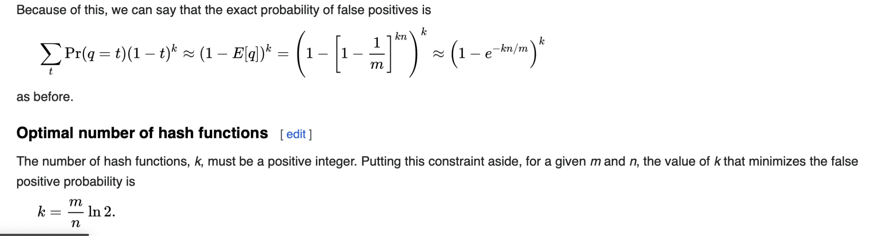
Bloom Filter

